Slide 1
CPFEM Parametric study

Slide 2
Spaces of exploration
Dimensionality (D space)
Morphological space (XYZ space)
Crystallographic texture space (G space)
Material model space (MM space)
Finite element meshing space (Mesh space)
Boundary condition space (BC space): Domain and mesh
Grain structure feature space (GSF space)

Slide 3
Morphological space (XYZ space)
Size parameter
Domain size
2d
Count parameter
Number of grains across cross section
Poly-crystal
3d
Ratio parameter
Ratio Area of boundary to non-boundary grains
Distribution: A, B, C, D
Grain area / volume
Particles / Precipitate
Grain area / volume parameters
Grain perimeter / surface area parameters
A: Size parameter
Junction point angles
Aspect ratio
B: Shape parameter
Sphericity, Circularity, Paris factor, etc.
2d
Poly-crystal internal features
GB.Line / GB.Surface roughness
3d
C: Orientation parameter
Grain major axis orientation
Grain boundary morpho. orientation
D: Local neighbourhood parameter
Number of neighbouring grains
Local to neighbour grain intercept length ratrio

Slide 4
Crystallographic texture space (G space)
Number of texture components
Re-crystallized texture
Texture volume fraction
Type of crystallographic texture
Rolling texture
Texture intensity
Extrusion texture
Mac-Kenzie Mis.Ori. distribution

Slide 5
Finite Element Mesh space (Mesh space)
Conformal mesh
Inclusion of grain boundary zone
Mesh area/volume density
El. Size (global)
Non-conformal mesh
Inclusion of junction point zone
low priority for parameter sensitivity
important5 from post-processing perspective

Slide 6
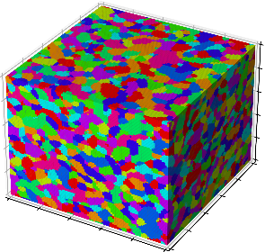

Domain Boundary condition space (DBC space)
Periodic boundary conditions are inherent in
Domain Non-Periodic boundary condition
Domain Periodic boundary condition

Slide 7
FE Boundary condition space (FEBC space)
2D: Edges constrained against translation along normal axes
3D: Faces constrained against translation along normal axes
2D: Edges constrained against translation along normal axes and rotation about its axis
3D: Faces constrained against translation along normal axes and rotation about its edge axes
Use the best practice approacxh
Low priority

Slide 8
Can the wrapped - opposite grains in the 3D and 2D grains be given the same crystallographgic oprientation in UPXO during the orientation mapping phase? ---> FEATURE REQUEST

Slide 9
Grain structure feature space (GSF space)
Twin region characterisitcs
PAP characterisitcs
Block characterisitcs
Precipitate shape and size

